Slide 1

Deep Learning Model: Inception for Object Detection (Tech Details)
MK199 Segmentation fault

Slide 2
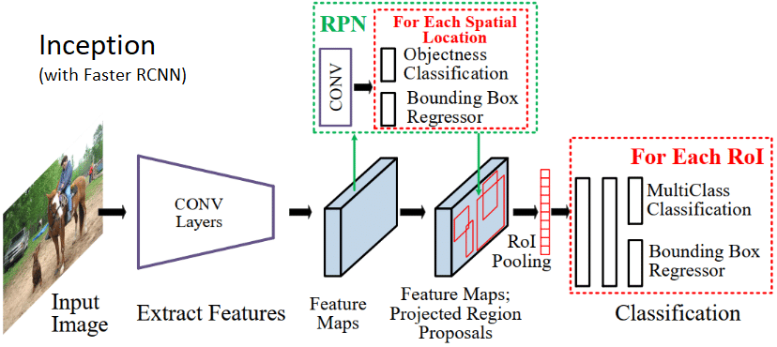
Inception v3 Model with Faster RCNN (TensorFlow)
Notes:
Explain about Inception model and how faster rcnn just helps in Object Detection. Focus less on rcnn part. If Tensorflow asked explain how we coded in tensorflow with each layer with backend to c/c++ for computing etc.

Slide 3
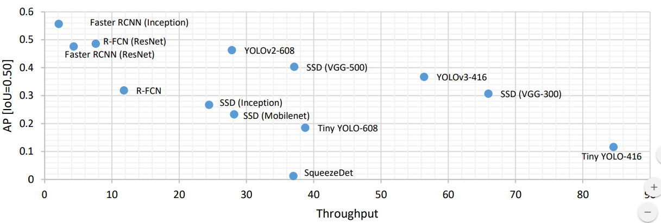
Comparison With Other Models (Inference Time vs mAP)
Our Model
Higher mAP: Better is the model
Higher Throughput: More quickly is the result
Notes:
Throughput == Inference Time. Explain the point of inference vs maP

Slide 4
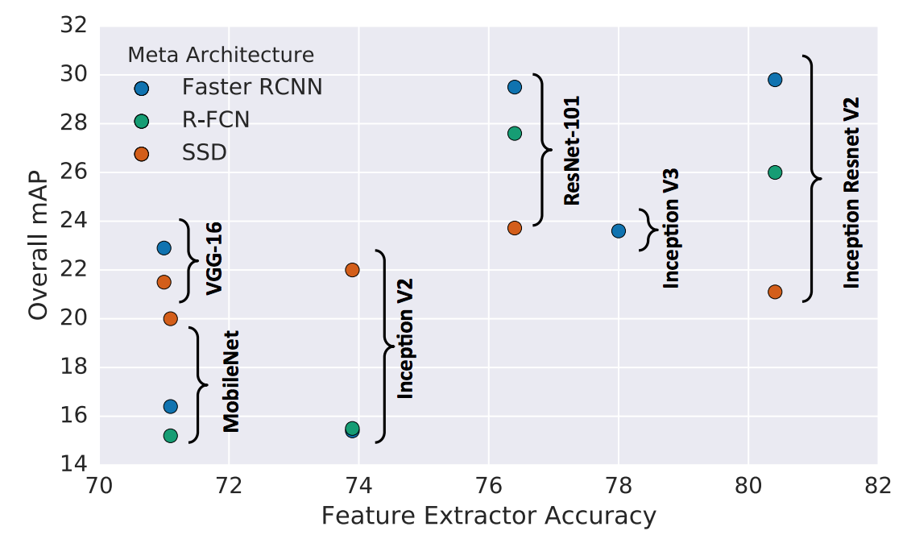
Comparison with Other Models (Feature Accuracy vs mAP)

